Slide 1

Programming Languages
Third Edition
Chapter 4
Logic Programming

Slide 2
Objectives
Understand the nature of logic programming
Understand Horn clauses
Understand resolution and unification
Become familiar with the Prolog language
Explore the problems with logic programming
Become familiar with the Curry language
Programming Languages, Third Edition

Slide 3
Introduction
Logic: the science of reasoning and proof
  Existed since the time of ancient Greek philosophers
Mathematical, or symbolic, logic: began with George Boole and Augustus De Morgan in the mid 1800s
Logic is closely associated with computers and programming languages
  Circuits are designed using Boolean algebra
  Logical statements are used to describe axiomatic semantics, the semantics of programming languages
Programming Languages, Third Edition

Slide 4
Introduction (cont’d.)
Logical statements can be used as formal specifications
Together with axiomatic semantics, they can be used to prove the correctness of a program in a purely mathematical way
Computers are used to implement the principles of mathematical logic
  Automatic deduction systems or automatic theorem provers turn proofs into computation
  Computation can be viewed as a kind of proof
  Led to the programming language Prolog
Programming Languages, Third Edition

Slide 5
Logic and Logic Programs
Must understand mathematical logic
First-order predicate calculus: a way of formally expressing logical statements
Logical statements: statements that are either true or false
Axioms: logical statements that are assumed to be true and from which other true statements can be proved
Programming Languages, Third Edition

Slide 6
Logic and Logic Programs (cont’d.)
First-order predicate calculus statement parts:
  Constants: usually numbers or names
  Predicates: names for functions that are true or false
  Functions: functions that return non-Boolean values
  Variables that stand for as yet unspecified quantities
  Connectives: operations such as and, or, not, implication (→) equivalence (←→)
  Quantifiers: operations that introduce variables
  Punctuation symbols: parentheses, comma, period
Programming Languages, Third Edition

Slide 7
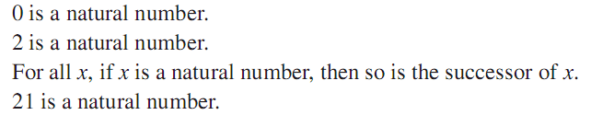
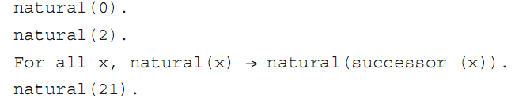
Logic and Logic Programs (cont’d.)
Example 1:
  These English statements are logical statements:
  Translation into predicate calculus:
Programming Languages, Third Edition

Slide 8
Logic and Logic Programs (cont’d.)
Example 1 (cont’d.):
  First and third statements are axioms
  Second statement can be proved since:
  Fourth statement cannot be proved from the axioms so can assumed to be false
  x in the third statement is a variable that stands for an as yet unspecified quantity
Programming Languages, Third Edition

Slide 9
Logic and Logic Programs (cont’d.)
Universal quantifier: a relationship among predicates is true for all things in the universe named by the variable
  Ex: for all x
Existential quantifier: a predicate is true of at least one thing in the universe indicated by the variable
  Ex: there exists x
A variable introduced by a quantifier is said to be bound by the quantifier
Programming Languages, Third Edition

Slide 10
Logic and Logic Programs (cont’d.)
A variable not bound by a quantifier is said to be free
Arguments to predicates and functions can only be terms: combinations of variables, constants, and functions
  Terms cannot contain predicates, quantifiers, or connectives
Programming Languages, Third Edition

Slide 11
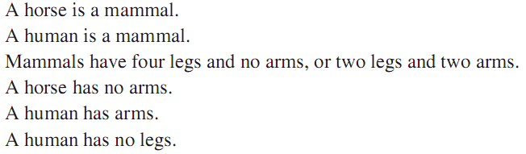
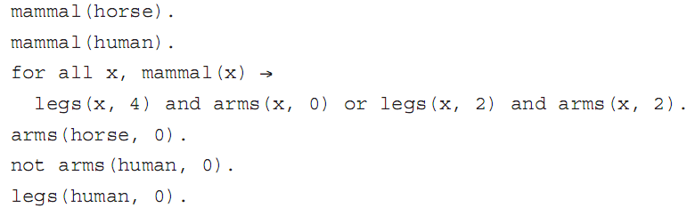
Logic and Logic Programs (cont’d.)
Example 2:
Programming Languages, Third Edition

Slide 12

Logic and Logic Programs (cont’d.)
First-order predicate calculus also has inference rules
Inference rules: ways of deriving or proving new statements from a given set of statements
Example: from the statements a→b and b→c, one can derive the statement a→c, written formally as:
Programming Languages, Third Edition

Slide 13
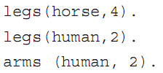
Logic and Logic Programs (cont’d.)
From Example 2, we can derive these statements:
Theorems: statements derived from axioms
Logic programming: a collection of statements is assumed to be axioms, and from them a desired fact is derived by the application of inference rules in some automated way
Programming Languages, Third Edition

Slide 14
Logic and Logic Programs (cont’d.)
Logic programming language: a notational system for writing logical statements together with specified algorithms for implementing inference rules
Logic program: the set of logical statements that are taken to be axioms
The statement(s) to be derived can be viewed as the input that initiates the computation
  Also called queries or goals
Programming Languages, Third Edition

Slide 15
Logic and Logic Programs (cont’d.)
Logic programming systems are sometimes referred to as deductive databases
  Consist of a set of statements and a deduction system that can respond to queries
  System can answer queries about facts and queries involving implications
Control problem: specific path or sequence of steps used to derive a statement
Programming Languages, Third Edition

Slide 16
Logic and Logic Programs (cont’d.)
Logical programming paradigm (Kowalski):
algorithm = logic + control
Compare this with imperative programming (Wirth):
algorithms = data structures + programs
Since logic programs do not express the control, in theory, operations can be carried out in any order or simultaneously
  Logic programming languages are natural candidates for parallelism
Programming Languages, Third Edition

Slide 17
Logic and Logic Programs (cont’d.)
There are problems with logic programming systems
Automated deduction systems have difficulty handling all of first-order predicate calculus
  Too many ways of expressing the same statements
  Too many inference rules
Most logic programming systems restrict themselves to a particular subset of predicate calculus called Horn clauses
Programming Languages, Third Edition

Slide 18

Horn Clauses
Horn clause: a statement of the form
The a_{i} are only allowed to be simple statements
  No or connectives and no quantifiers allowed
This statement says that a₁ through a_{n} imply b, or that b is true if all the a_{i} are true
  b is the head of the clause
  The a₁,…,a_{n} is the body of the clause
If there are no a_{i}’s, the clause becomes → b
  b is always true and is called a fact
Programming Languages, Third Edition

Slide 19

Horn Clauses (cont’d.)
Horn clauses can be used to express most, but not all, logical statements
Example 4: first-order predicate calculus:
Translate these into Horn clauses by dropping the quantifier:
Programming Languages, Third Edition

Slide 20


Horn Clauses (cont’d.)
Example 5: logical description for the Euclidian algorithm for greatest common divisor of two positive integers u and v:
First-order predicate calculus:
Programming Languages, Third Edition

Slide 21
Horn Clauses (cont’d.)
Note that gcd(u,v,w) is a predicate expressing that w is the gcd of u and v
Translate into Horn clauses by dropping the quantifiers:
Programming Languages, Third Edition

Slide 22

Horn Clauses (cont’d.)
Example 6: logical statements
Predicate calculus:
Horn clause:
Programming Languages, Third Edition

Slide 23

Horn Clauses (cont’d.)
Example 7: logical statements:
Predicate calculus:
This may be approximated by these Horn clauses:
In general, the more connectives that appear on the right of a → connective, the harder it is to translate into a set of Horn clauses
Programming Languages, Third Edition

Slide 24

Horn Clauses (cont’d.)
Procedural interpretation: Horn clauses can be reversed to view them as a procedure
This becomes procedure b, wherein the body is the operations indicated by the a_{i}’s
  Similar to how context-free grammar rules are interpreted as procedure definitions in recursive descent parsing
  Logic programs can be used to directly construct parsers
Programming Languages, Third Edition

Slide 25
Horn Clauses (cont’d.)
Parsing of natural language was a motivation for the original development of Prolog
Definite clause grammars: the particular kind of grammar rules used in Prolog programs
Horn clauses can also be viewed as specifications of procedures rather than strictly as implementations
Example: specification of a sort procedure:
Programming Languages, Third Edition

Slide 26

Horn Clauses (cont’d.)
Horn clauses do not supply the algorithms, only the properties that the result must have
Most logic programming systems write Horn clauses backward and drop the and connectives:
Note the similarity to standard programming language expression for the gcd:
Programming Languages, Third Edition

Slide 27

Horn Clauses (cont’d.)
Variable scope:
  Variables used in the head can be viewed as parameters
  Variables used only in the body can be viewed as local, temporary variables
Queries or goal statements: the exact opposite of a fact
  Are Horn clauses with no head
  Examples:
Programming Languages, Third Edition

Slide 28

Resolution and Unification
Resolution: an inference rule for Horn clauses
  If the head of the first Horn clause matches with one of the statements in the body of the second Horn clause, can replace the head with the body of the first in the body of the second
Example: given two Horn clauses
  If b_{i} matches a, then we can infer this clause:
Programming Languages, Third Edition

Slide 29
Resolution and Unification (cont’d.)
Example: given b←a and c←b
  Resolution says c←a
Another way: combine left-hand and right-hand sides of both clauses, and cancel statements that match on both sides
Example: given b←a and c←b
  Combine: b,c,←a,b
  Cancel the b on both sides: c←a
Programming Languages, Third Edition

Slide 30
Resolution and Unification (cont’d.)
A logic processing system uses this process to match a goal and replace it with the body, creating a new list of goals, called subgoals
If all goals are eventually eliminated, deriving the empty Horn clause, then the original statement has been proved
To match statements with variables, set the variables equal to terms to make the statements identical and then cancel from both sides
  This process is called unification
  Variables used this way are said to be instantiated
Programming Languages, Third Edition

Slide 31
Resolution and Unification (cont’d.)
Example 10: gcd with resolution and unification
Goal:
Resolution fails with first clause (10 does not match 0), so use the second clause and unify:
Programming Languages, Third Edition

Slide 32
Resolution and Unification (cont’d.)
Example 10 (cont’d.):
  If zero(10) is false, then not zero(10) is true
  Simplify 15 mod 10 to 5, and cancel gcd (15, 10, x) from both sides, giving:
  Use unification as before:
  To get this subgoal:
  This now matches the first rule, so setting x to 5 gives the empty statement
Programming Languages, Third Edition

Slide 33
Resolution and Unification (cont’d.)
A logic programming system must have a fixed algorithm that specifies:
  Order in which to attempt to resolve a list of goals
  Order in which clauses are used to resolve goals
In some cases, order can have a significant effect on the answers found
Logic programming systems using Horn clauses and resolution with prespecified orders require that the programmer is aware of the way the system produces answers
Programming Languages, Third Edition

Slide 34
The Language Prolog
Prolog: the most widely used logic programming language
  Uses Horn clauses
  Implements resolution via a strictly depth-first strategy
There is now an ISO standard for Prolog
  Based on the Edinburgh Prolog version developed in the late 1970s and early 1980s
Programming Languages, Third Edition

Slide 35
Notation and Data Structures
Prolog notation is almost identical to Horn clauses
  Implication arrow ← becomes :-
  Variables are uppercase, while constants and names are lowercase
  In most implementations, can also denote a variable with a leading underscore
  Use comma for and, semicolon for or
  List is written with square brackets, with items separated by commas
  Lists may contain terms or variables
Programming Languages, Third Edition

Slide 36
Notation and Data Structures (cont’d.)
Can specify head and tail of list using a vertical bar
Example: [H|T] = [1, 2, 3] means H = 1, T = [2, 3]
Example: [X, Y|Z] = [1, 2, 3] means X=1, Y=2, and Z=[3]
Built-in predicates include not, =, and I/O operations read, write, and nl (newline)
Less than or equal is usually written =< to avoid confusion with implication
Programming Languages, Third Edition

Slide 37
Execution in Prolog
Most Prolog systems are interpreters
Prolog program consists of:
  Set of Horn clauses in Prolog syntax, usually entered from a file and stored in a dynamically maintained database of clauses
  Set of goals, entered from a file or keyboard
At runtime, the Prolog system will prompt for a query
Programming Languages, Third Edition

Slide 38

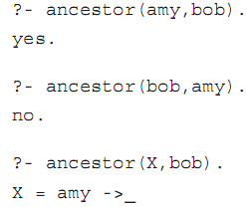
Execution in Prolog (cont’d.)
Example 11: clauses entered into database
Queries:
Programming Languages, Third Edition

Slide 39
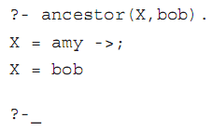
Execution in Prolog (cont’d.)
Example 11 (cont’d.): use semicolon at prompt (meaning or)
Use carriage return to cancel the continued search
Programming Languages, Third Edition

Slide 40


Arithmetic
Prolog has built-in arithmetic operations
  Terms can be written in infix or prefix notation
Prolog cannot tell when a term is arithmetic or strictly data
  Must use built-in predicate is to force evaluation
Programming Languages, Third Edition

Slide 41

Arithmetic (cont’d.)
Greatest common divisor algorithm
  In generic Horn clauses:
  In Prolog:
Programming Languages, Third Edition

Slide 42
Unification
Unification: process by which variables are instantiated to match during resolution
  Basic expression whose semantics is determined by unification is equality
Prolog’s unification algorithm:
  Constant unifies only with itself
  Uninstantiated variable unifies with anything and becomes instantiated to that thing
  Structured term (function applied to arguments) unifies with another term only if the same function name and same number of arguments
Programming Languages, Third Edition

Slide 43
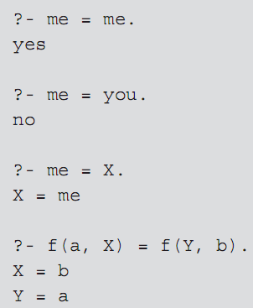
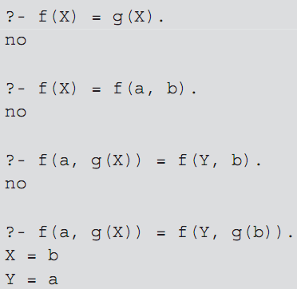
Unification (cont’d.)
Examples:
Programming Languages, Third Edition

Slide 44

Unification (cont’d.)
Unification causes uninstantiated variables to share memory (to become aliases of each other)
  Example: two uninstantiated variables are unified
Pattern-directed invocation: using a pattern in place of a variable unifies it with a variable used in that place in a goal
  Example:
Programming Languages, Third Edition

Slide 45
Unification (cont’d.)
Append procedure:
First clause: appending a list to the empty list gives just that list
Second clause: appending a list whose head is A and tail is B to a list Y gives a list whose head is also A and whose tail is B with Y appended
Programming Languages, Third Edition

Slide 46




Unification (cont’d.)
Append procedure rewritten more concisely:
  Append can also be run backward and find all the ways to append two lists to get a specified list:
Programming Languages, Third Edition

Slide 47

Unification (cont’d.)
Reverse procedure:
Programming Languages, Third Edition

Slide 48
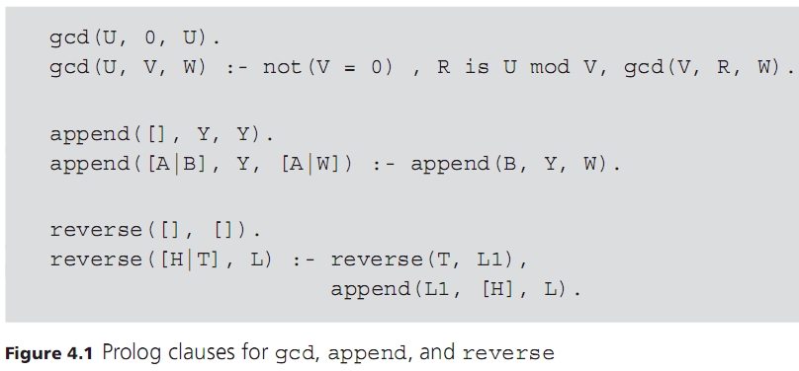
Unification (cont’d.)
Programming Languages, Third Edition

Slide 49
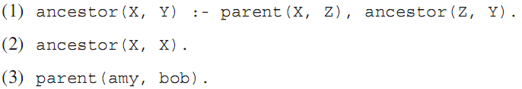
Prolog’s Search Strategy
Prolog applies resolution in a strictly linear fashion
  Replaces goals from left to right
  Considers clauses in the database from top down
  Subgoals are considered immediately
  This search strategy results in a depth-first search on a tree of possible choices
Example:
Programming Languages, Third Edition

Slide 50
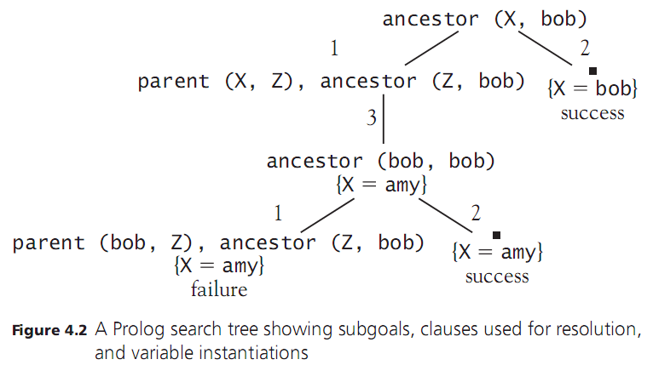
Prolog’s Search Strategy (cont’d.)
Programming Languages, Third Edition

Slide 51
Prolog’s Search Strategy (cont’d.)
Leaf nodes in the tree occur either when no match is found for the leftmost clause or when all clauses have been eliminated (success)
If failure, or the user indicates a continued search with a semicolon, Prolog backtracks up the tree to find further paths
Depth-first strategy is efficient: can be implemented in a stack-based or recursive fashion
  Can be problematic if the search tree has branches of infinite depth
Programming Languages, Third Edition

Slide 52
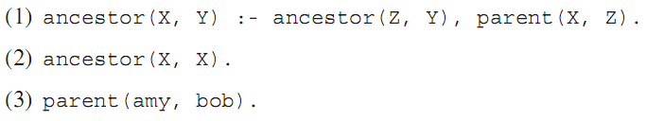
Prolog’s Search Strategy (cont’d.)
Example: same clauses in different order
Causes Prolog to go into an infinite loop attempting to satisfy ancestor (Z, Y), continually reusing the first clause
Breadth-first search would always find solutions if they exist
  Far more expensive than depth-first, so not used
Programming Languages, Third Edition

Slide 53
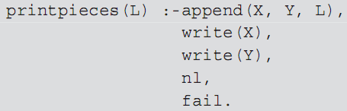
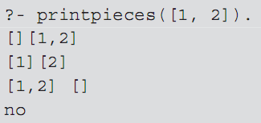
Loops and Control Structures
Can use the backtracking of Prolog to perform loops and repetitive searches
  Must force backtracking even when a solution is found by using the built-in predicate fail
Example:
Programming Languages, Third Edition

Slide 54

Loops and Control Structures (cont’d.)
Use this technique also to get repetitive computations
Example: these clauses generate all integers greater than or equal to 0 as solutions to the goal num(X)
The search tree has an infinite branch to the right
Programming Languages, Third Edition

Slide 55
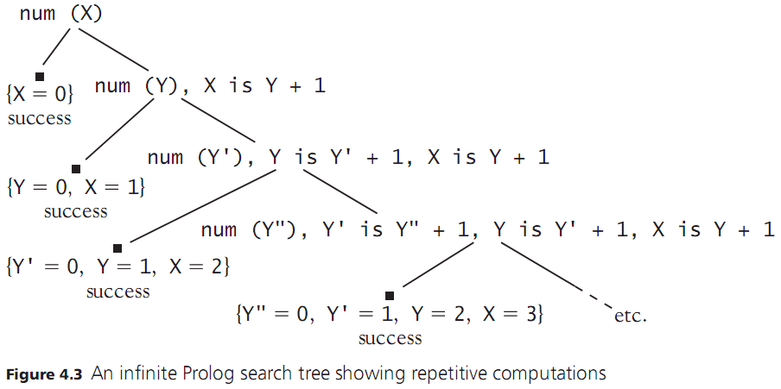
Loops and Control Structures (cont’d.)
Programming Languages, Third Edition

Slide 56
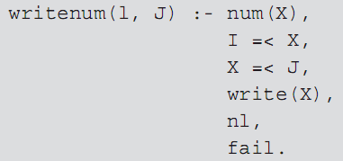
Loops and Control Structures (cont’d.)
Example: trying to generate integers from 1 to 10
Causes an infinite loop after X = 10, even though X =< 10 will never succeed
cut operator (written as !) freezes a choice when it is encountered
Programming Languages, Third Edition

Slide 57

Loops and Control Structures (cont’d.)
If a cut is reached on backtracking, search of the subtrees of the parent node stops, and the search continues with the grandparent node
  Cut prunes the search tree of all other siblings to the right of the node containing the cut
Example:
  Only X = amy will be found since the branch containing X = bob will be pruned
Programming Languages, Third Edition

Slide 58
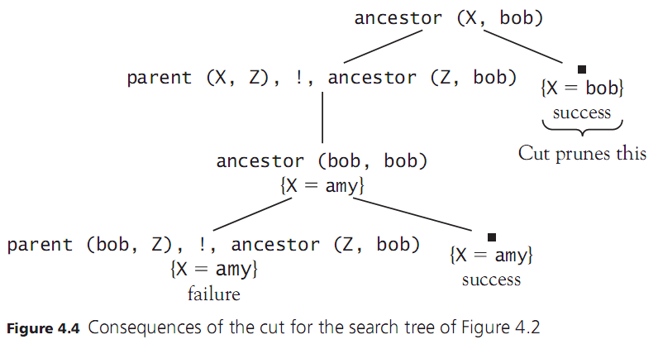
Loops and Control Structures (cont’d.)
Programming Languages, Third Edition

Slide 59

Loops and Control Structures (cont’d.)
Rewriting this example:
  No solutions will be found
Programming Languages, Third Edition

Slide 60
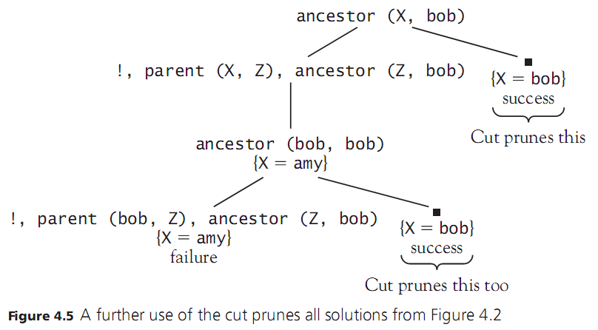
Loops and Control Structures (cont’d.)
Programming Languages, Third Edition

Slide 61

Loops and Control Structures (cont’d.)
Rewriting again:
  Both solutions will still be found since the right subtree of ancestor(X, bob) is not pruned
Cut can be used to reduce the number of branches in the subtree that need to be followed
Also solves the problem of the infinite loop in the program to print numbers between I and J shown earlier
Programming Languages, Third Edition

Slide 62
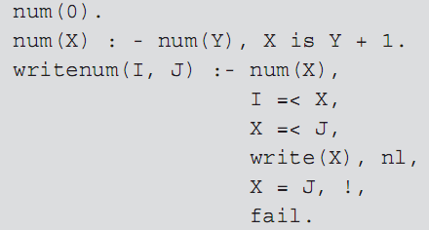
Loops and Control Structures (cont’d.)
One solution to infinite loop shown earlier:
  X = J will succeed when the upper-bound J is reached
  The cut will cause backtracking to fail, halting the search for new values of X
Programming Languages, Third Edition

Slide 63


Loops and Control Structures (cont’d.)
Can also use cut to imitate if-else constructs in imperative and functional languages, such as:
D = if A then B else C
Prolog code:
Could achieve almost same result without the cut, but A would be executed twice
Programming Languages, Third Edition

Slide 64
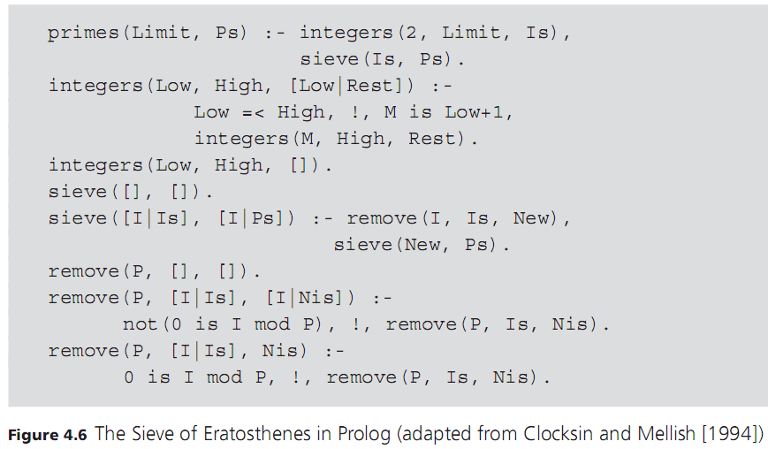
Loops and Control Structures (cont’d.)
Programming Languages, Third Edition

Slide 65
Problems with Logic Programming
Original goal of logic programming was to make programming a specification activity
  Allow the programmer to specify only the properties of a solution and let the language implementation provide the actual method for computing the solution
Declarative programming: program describes what a solution to a given problem is, not how the problem is solved
Logic programming languages, especially Prolog, have only partially met this goal
Programming Languages, Third Edition

Slide 66
Problems with Logic Programming (cont’d.)
The programmer must be aware of the pitfalls in the nature of the algorithms used by logic programming systems
The programmer must sometimes take an even lower-level perspective of a program, such as exploiting the underlying backtrack mechanism to implement a cut/fail loop
Programming Languages, Third Edition

Slide 67
The Occur-Check Problem in Unification
Occur-check problem: when unifying a variable with a term, Prolog does not check whether the variable itself occurs in the term it is being instantiated to
Example:
This will be true if there exists an X for which X is its own successor
But even in the absence of any other clauses for successor, Prolog answers yes
Programming Languages, Third Edition

Slide 68
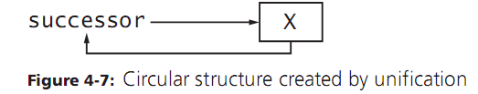
The Occur-Check Problem in Unification (cont’d.)
This becomes apparent if we make Prolog try to print such an X:
  Prolog responds with an infinite loop because unification has constructed X as a circular structure
  What should be logically false now becomes a programming error
Programming Languages, Third Edition

Slide 69

Negation as Failure
Closed-world assumption: something that cannot be proved to be true is assumed to be false
  Is a basic property of all logic programming systems
Negation as failure: the goal not(X) succeeds whenever the goal X fails
Example: program with one clause:
If we ask:
  The answer is yes since the system has no knowledge of mother
  If we add facts about mother, this would no longer be true
Programming Languages, Third Edition

Slide 70
Negation as Failure (cont’d.)
Nonmonotonic reasoning: the property that adding information to a system can reduce the number of things that can be proved
  This is a consequence of the closed-world assumption
A related problem is that failure causes instantiation of variables to be released by backtracking
  A variable may no longer have an appropriate value after failure
Programming Languages, Third Edition

Slide 71
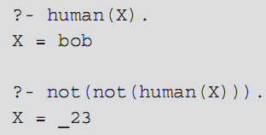
Negation as Failure (cont’d.)
Example: assumes the fact human(bob)
The goal not(not(human(X))) succeeds because not(human(X)) fails, but the instantiation of X to bob is released
Programming Languages, Third Edition

Slide 72
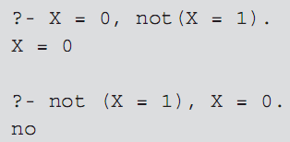
Negation as Failure (cont’d.)
Example:
  The second pair of goals fails because X is instantiated to 1 to make X = 1 succeed, and then not(X=1) fails
  The goal X = 0 is never reached
Programming Languages, Third Edition

Slide 73

Horn Clauses Do Not Express
All of Logic
Not every logical statement can be turned into Horn clauses
  Statements with quantifiers may be problematic
Example:
Attempting to use Prolog, we might write:
  Causes an error: trying to redefine the not operator
Programming Languages, Third Edition

Slide 74
Horn Clauses Do Not Express
All of Logic (cont’d.)
A better approximation would be simply p(a)
  Closed-world assumption will force not(p(X)) to be true for all X not equal to a
  But this is really the logical equivalent of:
  This is not the same as the original statement
Programming Languages, Third Edition

Slide 75
Control Information in Logic Programming
Because of its depth-first search strategy and linear processing of goals and statements, Prolog programs also contain implicit information on control that can cause programs to fail
  Changing the order of the right-hand side of a clause may cause an infinite loop
  Changing the order of clauses may find all solutions but still go into an infinite loop searching for further (nonexistent) solutions
Programming Languages, Third Edition

Slide 76
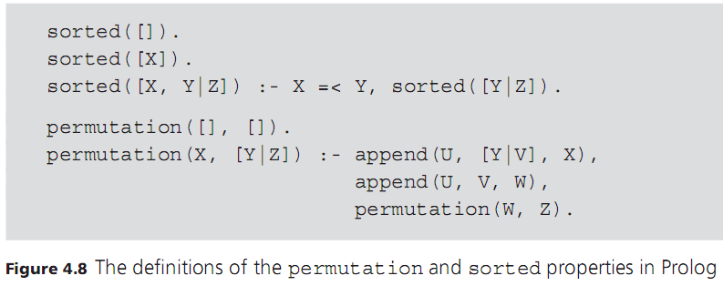
Control Information in Logic Programming (cont’d.)
Programming Languages, Third Edition

Slide 77
Control Information in Logic Programming (cont’d.)
This is a mathematical definition of what it means for a list of numbers to be sorted in increasing order
  As a program, it is one of the slowest possible sorts
  Permutations of the unsorted list are generated until one of them happens to be sorted
One would want a logic programming system to accept a mathematical definition and find an efficient algorithm to compute it
Instead, we must specify actual steps in the algorithm to get a reasonable efficient sort
Programming Languages, Third Edition

Slide 78
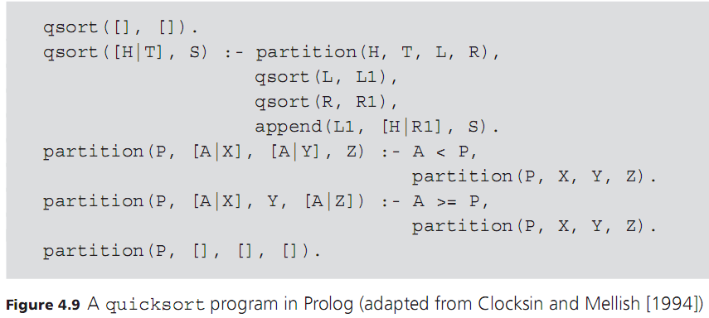
Control Information in Logic Programming (cont’d.)
Programming Languages, Third Edition

Slide 79
Curry: A Functional Logic Language
In a functional language, a program is a set of function definitions that specify rules for operating on data to transform it into other data
In a logic language, a program is a set of rules and facts from which a proof is constructed for a solution to a problem
Each of these has some specific disadvantages
The language Curry brings together the advantages of functional and logic programming in a single language
Programming Languages, Third Edition

Slide 80
Functional Programming in Curry
Curry is an extension of Haskell
  Retains the syntax and semantics of Haskell for functional programming
  Adds new syntax and semantics for logic programming
Function definitions are sets of equations as in Haskell
Curry uses lazy evaluation
Programming Languages, Third Edition

Slide 81
Adding Nondeterminism, Conditions, and Backtracking
A pure functional language supports only deterministic computation
  Application of a function to a given set of arguments always produces the same value
Problems such as flipping a coin are underspecified, as their solutions come from a set of values
Curry supports nondeterminism by allowing a set of equations for a function to be tried in no particular order, using the choice operator ?
Programming Languages, Third Edition

Slide 82

Adding Nondeterminism, Conditions, and Backtracking (cont’d.)
Example:
Curry does not automatically try the first equation
If one fails, another equation will be tried
A nondeterministic function for flipping a coin:
For the sorting problem, we can use Curry’s nondeterminism and backtracking to produce a simple implementation
Programming Languages, Third Edition

Slide 83


Adding Nondeterminism, Conditions, and Backtracking (cont’d.)
Function sorted expects a list as an argument and returns a sorted list of the same elements:
Third equation includes a condition (to the right of the | symbol) that permits evaluation of its right side only if the first element in the list is less than or equal to the second element
Programming Languages, Third Edition

Slide 84

Adding Nondeterminism, Conditions, and Backtracking (cont’d.)
Function permutation inserts the first element of a nonempty list into a permutation of the rest of that list:
Function insert places an element at an arbitrary position in a list
  Defined nondeterministically for nonempty lists
Programming Languages, Third Edition

Slide 85
Adding Logical Variables and Unification
Logical variables and unification give Curry the ability to solve equations with unknown or partial information
  Involves viewing some variables as free in the sense that they can be instantiated in a way to satisfy a set of equations that includes them
Curry uses the symbol =:= to specify an equation to be solved in this manner
Example:
Programming Languages, Third Edition

